Slide 1
Survey
SKYPE SURVEY
Have you ever heard of Alexa or Echo dot before?
Never heard of it
I have a few friends named Alexa…
I’ve heard of it before, but never used it
I’ve used one a few times
I’ve used one many times
SKYPE SURVEY

Slide 2

Hacking with Alexa
Aaron Anderson, Krista MacGillivray
September 19, 2018

Slide 3


Introduction
Moderator:
Aaron Anderson
Apps Services
North America
Speaker:
Krista MacGillivray
Cloud Integration
North America

Slide 4
Agenda
Topic approx. time
Welcome to Hacking with Amazon Alexa 01 min.
Introduction to Alexa & Voice UI 10 min.
Developing for Alexa 05 min.
Build Your First Alexa Skill 20 min.
Review 01 min.
Next Steps 03 min.
During this workshop you’ll learn the basics of how to build skills for Amazon Alexa to run on Alexa devices like the Amazon Tap or Echo. The provided content covers setting up Alexa Skills Kit, developing your first skill, deploying your skill to AWS Lambda, and submitting your skill for publication.
Acknowledgements:
Special thanks to Major League Hacking for the Amazon Alexa deck
The presentation was repurposed by Krista MacGillivray for Global Innovators Month

Slide 5
Survey
SKYPE SURVEY
What’s your level of experience working Alexa Skills?
Never worked with Alexa Skills before
I’ve worked on Alexa Skills once or twice
I’m a developer for Alexa
SKYPE SURVEY

Slide 6
Chapter 1: Welcome to Hacking with Alexa

Slide 7
What Will You Learn Today
1
Understand Voice User Interfaces & what you can build using them.
2
Meet Alexa, an intelligent personal assistant developed by Amazon.
3
Create your first voice powered app with Amazon Alexa.

Slide 8
Chapter 2: Introduction to Alexa & Voice UI

Slide 9
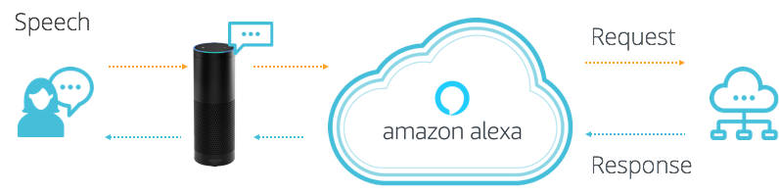
What is Alexa?
Alexa is a Voice User Interface (VUI), that lets you speak commands, instead of clicking buttons or typing on your keyboard.
Alexa listens to spoken input, uses it to execute tasks or skills in the cloud, and then returns output -- just like a JavaScript function.
Notes:
What to Say:
Voice User Interfaces (VUIs) enable you to speak commands rather than typing them on a keyboard or swiping a touchscreen.
Alexa is Amazon's voice service that listens to spoken input, uses it to execute computing tasks, and then returns output
What to Do:
Demonstrate Alexa by asking questions in front of the audience. If you have a physical device, use that. Otherwise, you can use the browser simulator (https://www.echosim.io/)
“Alexa, what is the weather?”
“Alexa, tell me a joke.”

Slide 10
What is Alexa - Continued
Alexa is an intelligent personal assistant developed by Amazon Lab126, made popular by the Amazon Echo. To date, over one million Amazon Echo, “Alexa” devices have been sold.
It is capable of voice interaction, music playback, making to-do lists, setting alarms, streaming podcasts, playing audiobooks, and providing weather, traffic, and other real time information
Alexa and Voice interactive capabilities are anticipated to be adopted by users at a similar pace to the way that mobile had been adopted in the early 2000’s.
“Chris Dargis, Chief E-commerce Officer for Pizza Hut, believes that adoption rates for voice-activated usage will be similar to if not greater than mobile. He notes that as the increased use of smart phones led to a gradual rise of mobile ordering to the point where it is more common, so too can voice-activated ordering jump from being a niche operation to one that it is regularly accessed via multiple platforms like Amazon Echo, laptops, mobile devices, and cars.”

Slide 11


Why do Voice Uis Matter?
Instead of typing, clicking, or tapping - we can physically separate ourselves from our devices and speak commands naturally.
Voice UIs can run code in the cloud and communicate with IoT devices, making them ideal for homes, cars, & more.

Slide 12






Capgemini’s Use Cases
Krista’s Cafe (Alexa,Chatbot and MuleSoft)
Mandjet (Alexa,Medical Chatbot, Incident System and MuleSoft)
Kitchen Triage (Alexa and MuleSoft)
Restaurant Ordering (Alexa and Mulesoft)

Slide 13




Press Coverage
Millennial Innovation Council Newsletter (MIC) - Alexa Skills/Chatbots with the Cloud Integration Team
Mulesoft Connects 2017 and 2018 –API-Driven IoT Insights Revolutionize Beer Inventory Management, presented by Buffalo Wild Wings
CFS Newsletter Pulse - Cloud Integration Innovation Team
Food Service Technology Conference

Slide 14

What Can You Do With Alexa
Alexa, ask Lyft for a Lyft Line to work.
Notes:
What to Say:
Alexa is programmable, so you can connect it to webapps and other APIs
You could build smart remotes for your TV, a skill to hail a cab, order a pizza, etc.
The next few slides contain some examples.
Lyft - you can ask Alexa to call a lyft cab to your location.

Slide 15


What Can You Do With Alexa
Alexa, ask Capital One, what did I spend?
Notes:
What to Say:
Capital One - Check on your bank account and spending habits.

Slide 16
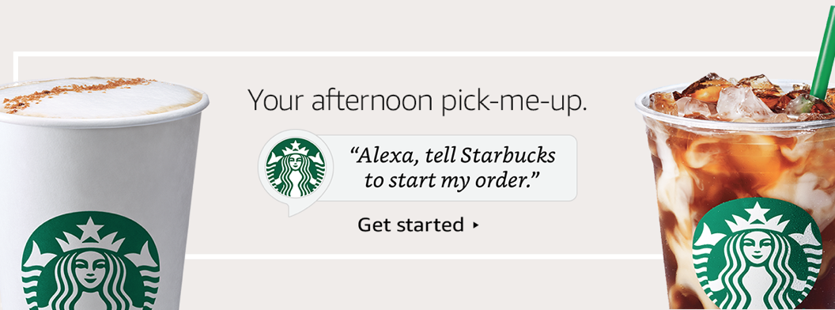
What Can You Do With Alexa
Alexa, tell Starbucks start my order.
Notes:
What to Say:
Starbucks - order your coffee ahead of time when you’re walking out the door.

Slide 17
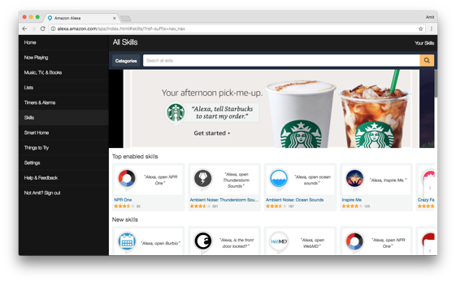
Alexa Has Skills. Lots of Them.
Companion app for device setup, skills, remote control, and more.
alexa.amazon.com
Notes:
What to Say:
Alexa has tons of skills you can use today
You can also search and discover skills by visiting amazon.com/skills
Today you are going to learn how to make one.
What to Do:
Ask participants if they have used any other Alexa apps or skills. Here are some other popular ones if you need examples:
NPR - Listen to Podcasts
Seamless - Order delivery to your house
Jeopardy - Play Jeopardy with Alexa.

Slide 18
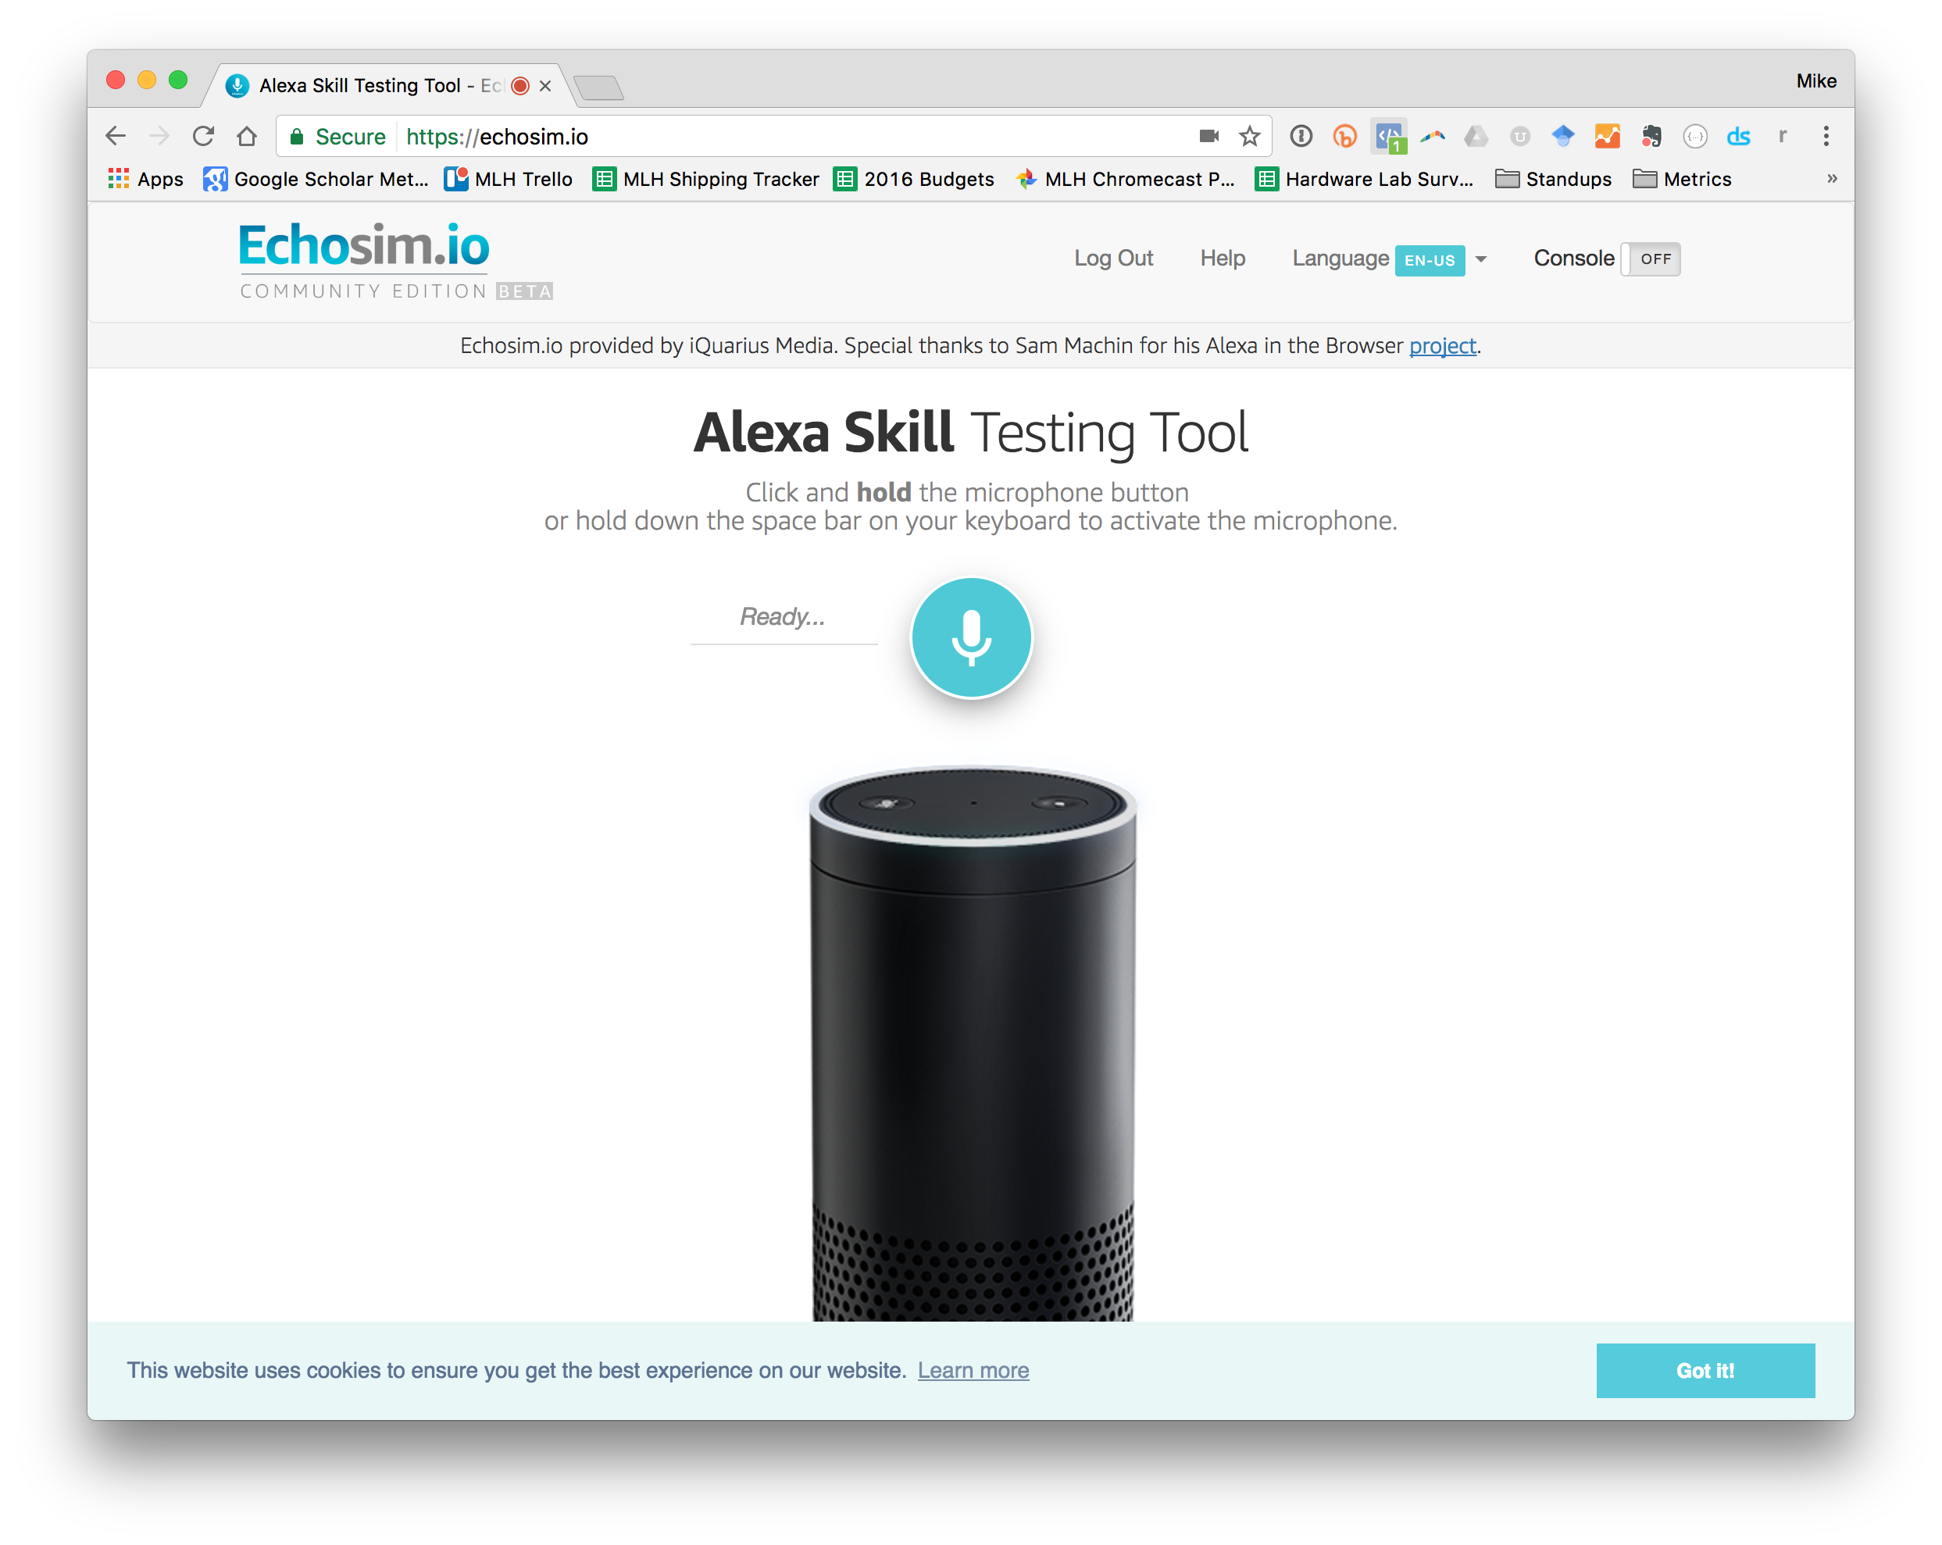


It’s LIVE Demo Time!
Try these commands:
“Alexa, tell me a joke!”
“Alexa, how much do you weigh?”
Don’t have an Alexa device?
Head to: echosim.io
Notes:
What to Say:
Time for participants to try out Alexa.
What to Do:
Let participants play with Alexa for about 5 minutes:
(If you have a physical device) Invite a few participants to come up and play with the Alexa.
(If you don’t have a device) Tell participants to head to echosim.io, login with their amazon account, and try a few commands

Slide 19
Chapter 3: Developing for Alexa

Slide 20
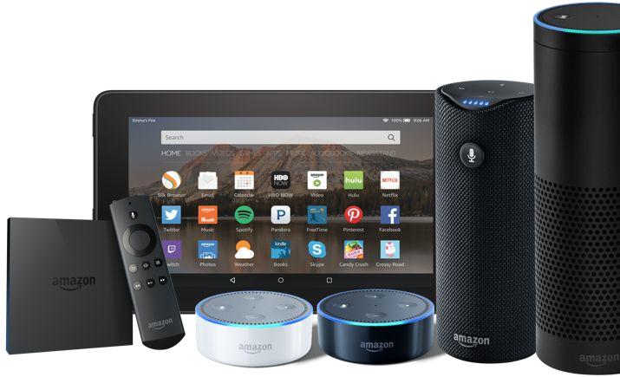
Why build an Alexa Skill?
Alexa, Amazon's voice service, is already integrated into Echo devices and can perform hundreds of skills.
Your skill can reach millions of customers with Alexa enabled devices.
Building with Alexa is free, easy, & fun!

Slide 21
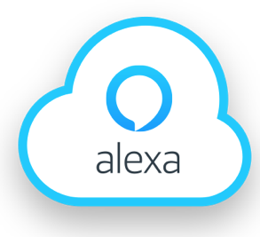

Alexa Skills Are Made of 2 Parts:
Front End - The Alexa Voice UI handles text to speech, converting the audio into something our app can use, etc.
Back End - The logic code that actually powers our app. Usually this is written on a service called AWS Lambda.
AWS Lambda
Notes:
What to Say:
Each Alexa skill is made of two parts
Front End is the Alexa Voice User Interface. This takes user speech and converts it into something the computer can understand
Back End is where your application logic lives. This takes the parsed speech and does something interesting with it.
FAQ:
What is AWS Lambda?
You can think of Lambda as an event-driven computing platform; Lambda runs when triggered by an event and executes code that’s been loaded into the system. You don’t need to setup or manage any servers, just write the code and Amazon takes care of the rest.

Slide 22

Speech Recognition is Hard.
You said: fȯr tē tīmz.
But, what did you mean?
Forty Times?
For Tea Times?
For Tee Times?
Four Tee Times?
Notes:
What to Say:
Understanding human speech is a hard problem for computers
There are two parts to understanding speech:
Speech Recognition - converting the audio to text
Natural Language Understanding - what is the context of this text?
Amazon has collected the top speech technology for you with Alexa, you don’t need to be an expert
What to Do:
Walk attendees through the example on the slides.
Imagine someone says “For Tea Times”
That could mean any one of these four things and Alexa can help you understand that
Reference iPhone speech to text service
English is hard (raise your hand)

Slide 23
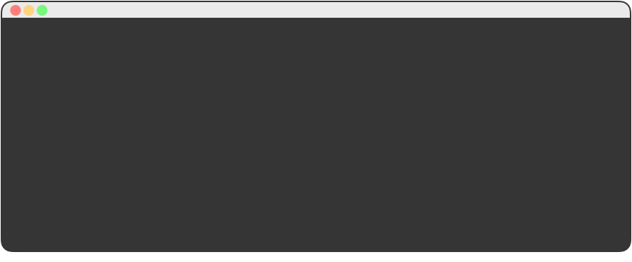
Alexa uses Sample Utterances for Training.
In order to map user input to a behavior, we provide training data, for each intent.
01 GetNewFactIntent a fact
02 GetNewFactIntent a Capgemini fact
03 GetNewFactIntent tell me a fact
04 GetNewFactIntent tell me a Capgemini fact
05 GetNewFactIntent give me a fact
06 GetNewFactIntent give me a Capgemini fact
07 GetNewFactIntent tell me trivia
08 GetNewFactIntent tell me a Capgemini trivia
09 GetNewFactIntent give me trivia
10 GetNewFactIntent give me a Capgemini trivia
11 GetNewFactIntent give me some information
Notes:
What to Say:
In order to map user input to something, we provide Alexa training data
This slide shows some example training data which takes the format:
[Skill] [Sample Speech to Trigger This Skill]
The sample skill is called “GetNewFactIntent” and “give me a fact” is an example thing someone might say to trigger it
Your list doesn’t need to be exhaustive (every possible combination), Alexa will use this data to train herself and learn new phrases

Slide 24
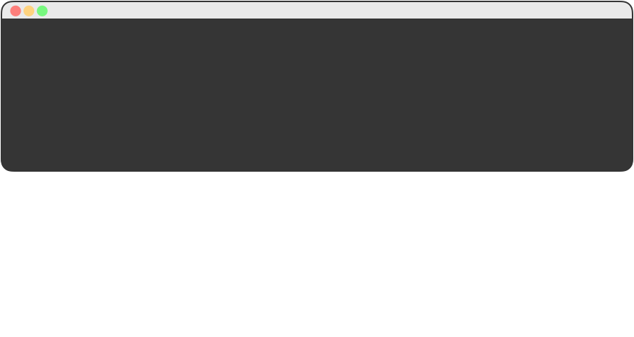
Alexa Maps Speech Input to Intents.
Once Alexa figures out what Intent you wanted, you can easily map that back to code.
01 {
02 "intents": [
03 { "intent": "GetNewFactIntent" },
04 { "intent": "AMAZON.HelpIntent" },
05 { "intent": "AMAZON.StopIntent" },
06 { "intent": "AMAZON.CancelIntent" }
07 ]
08 }
“Tell me a Fact about Capgemini” GetNewFactIntent
Notes:
What to Say:
An Alexa Skill (App) can have multiple commands.
We call those commands “Intents”
For example, an app that plays music may have a “Play” intent to start the music and a “Pause” intent to temporarily stop the music.
We tell Alexa what our intents are in a configuration file like this one.

Slide 25
Chapter 4: Build Your First Alexa Skill

Slide 26
Survey
SKYPE SURVEY
Do you know someone named Alexa who responds to you when you call her?
Yes
My wife’s name is Alexa but she doesn’t respond back when I call her.
Haha
SKYPE SURVEY

Slide 27
Demo: About the Capgemini Skill
Ask your Alexa:
“Alexa, open Capgemini Facts.”
“Alexa, ask Capgemini Facts for a fact.”
Don’t have an Alexa device?
Head to: echosim.io
Notes:
Setup:
Make sure you have the Capgemini Facts skill enabled. You can do this from the Alexa App on your phone.
What to Say:
We’re going to demo a skill that Capgemini made which returns facts about Capgemini
When you make your skill, it will return facts about YOU!
What to Do:
Demonstrate the Capgemini Alexa Skill by asking Alexa the following:
“Alexa, open Capgemini Facts.”
“Alexa, ask Capgemini Facts for a fact.”
If you have a physical device, use that. Otherwise use the Echo Simulator. (http://echosim.io/)

Slide 28
Steps to Build Your Skill:
To build your first skill, we’ll complete the following steps:
Write your skill code as an AWS Lambda function
Create an Alexa Skill in the Developer Portal
Connect Your Lambda Function to Your Skill
Test your Skill
Publish Your Skill
Notes:
What to Say:
These are the 5 steps to create an Alexa skill
In the first three steps, you will setup the main components and connect them together
At the end of this workshop, we’ll be testing out the skills you make
When you go home the next step is to publish your skill!

Slide 29
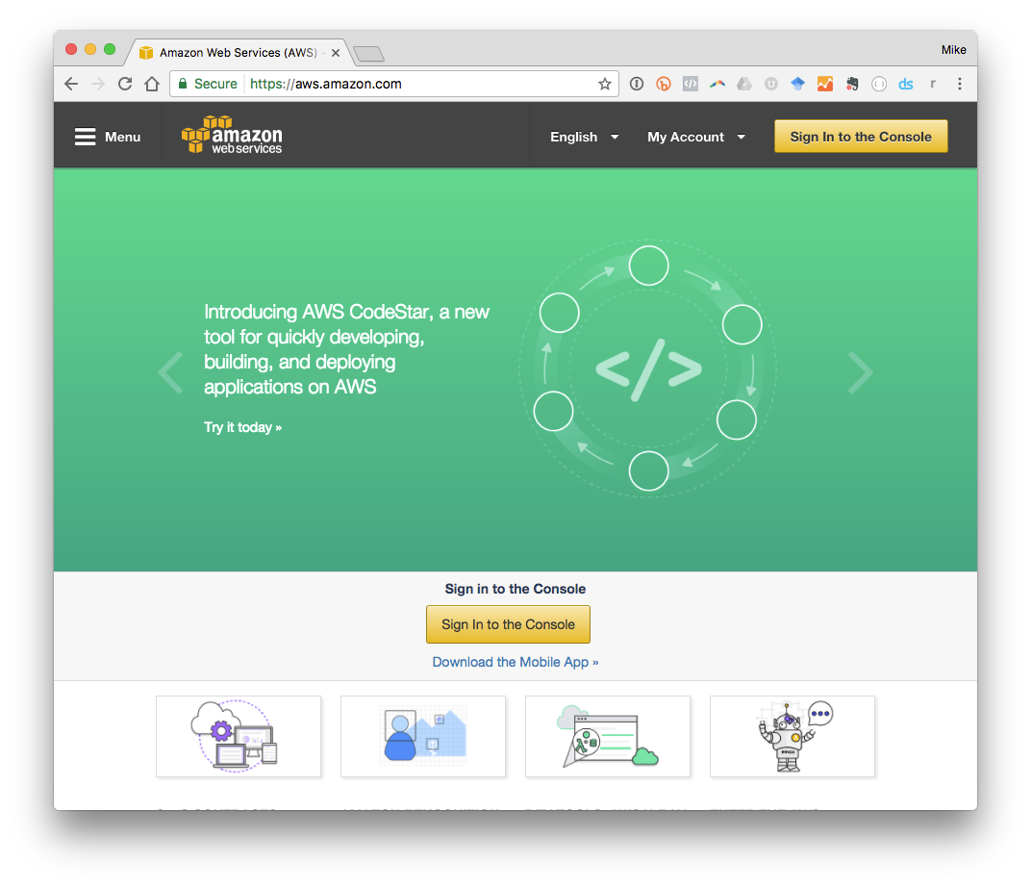
Sign into the AWS Console
Head over to:
aws.amazon.com
Click on
“Sign in to Console” to create your first Lambda Function.
Notes:
What to Say:
We’re going to create an AWS Lambda function to power our skill
We can do that from the AWS Console, so let’s go there now.
Once you’re on the landing page for the AWS Console, click sign in and either create an account or login if you have one
What to Do:
Have participants open the URL in their browser and log in to the AWS console
Participants may need to sign up for an AWS account during this step
Walk around and help people get to the AWS Console dashboard

Slide 30
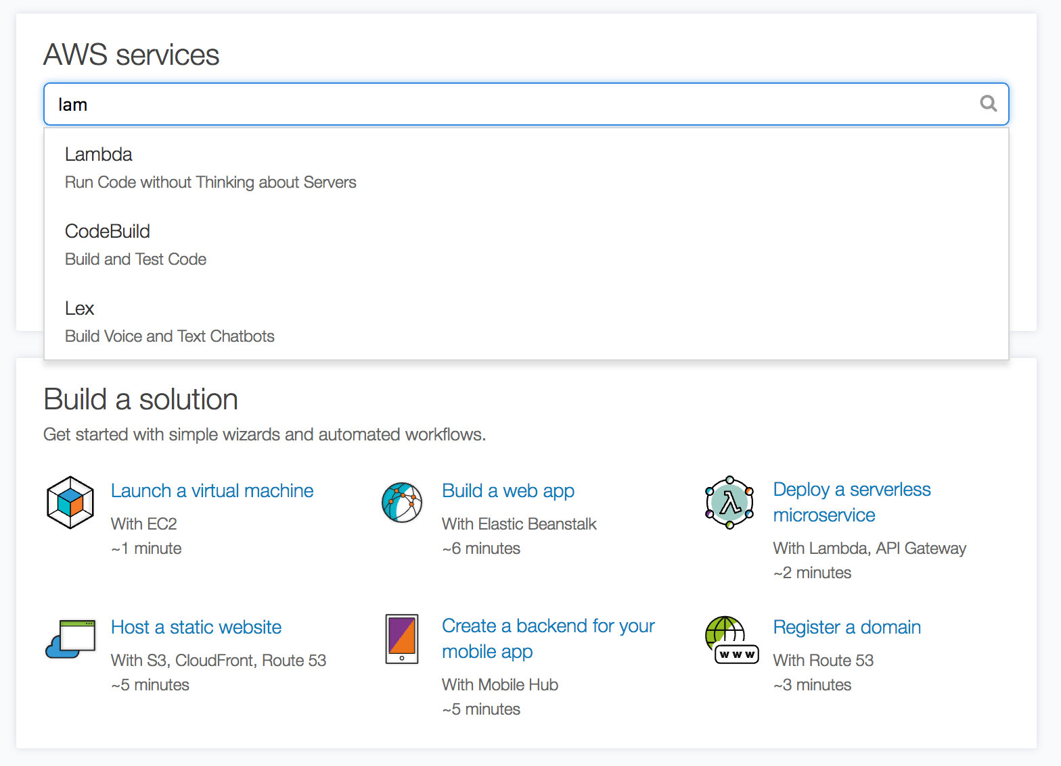
Navigate to the Lambda Manager.
You can search for Lambda in the search box or find it on the list of available services.
Notes:
What to Say:
The AWS Console is a portal to the many services AWS offers
We’re going to find the one that says “Lambda”.
You may need to click “Get Started” if you don’t see a screen like this one.
What to Do:
Have participants confirm they are using the “Northern Virginia” region.
They can see this in the top right corner, next to their name.
It should say “N. Virginia”
If it doesn’t, they can select “US East (N. Virginia)” from the region dropdown
Walk around and help participants find AWS Lambda on the console. Have them click the link to go to the dashboard.

Slide 31
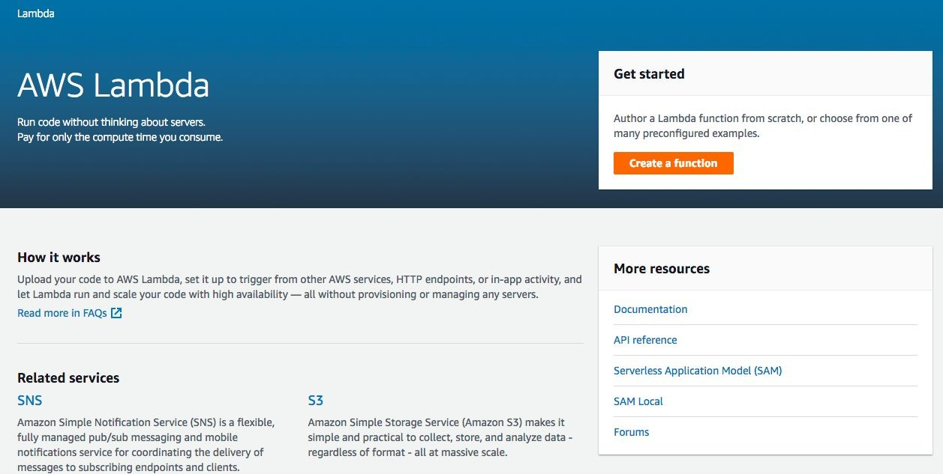
Create your First Lambda Function.
Each AWS Lambda Function is responsible for one thing (like returning facts!).
Instructions
Click “Create a Function” to create your first function!

Slide 32
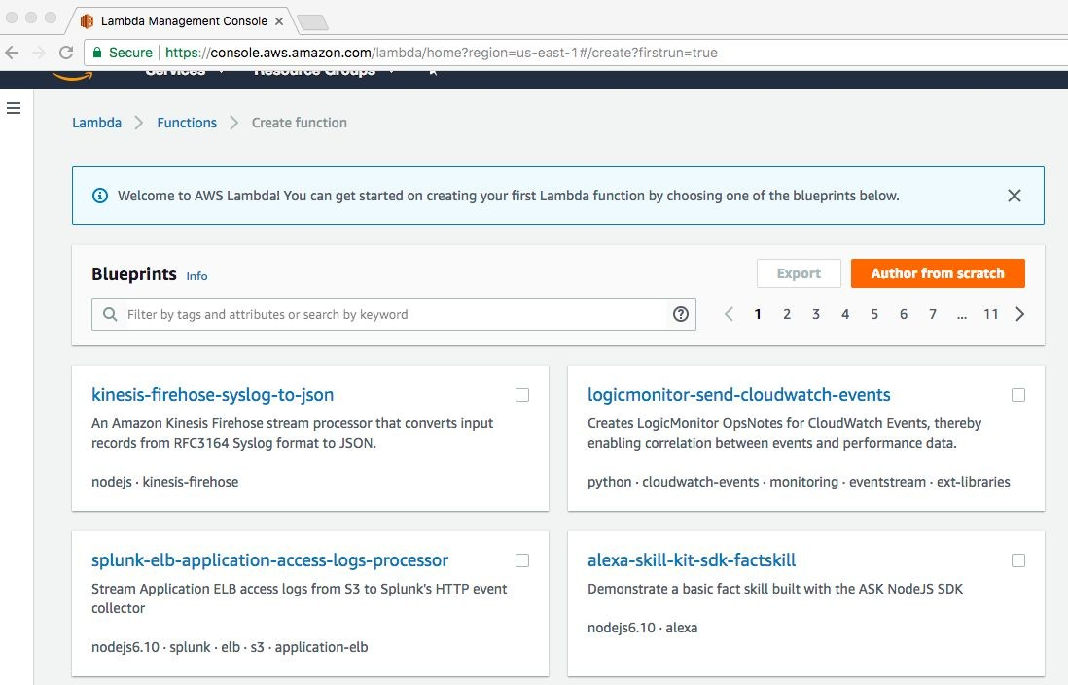
Choose a Blueprint.
Instructions
Select “alexa-skill-kit-sdk-factskill” from the options.

Slide 33
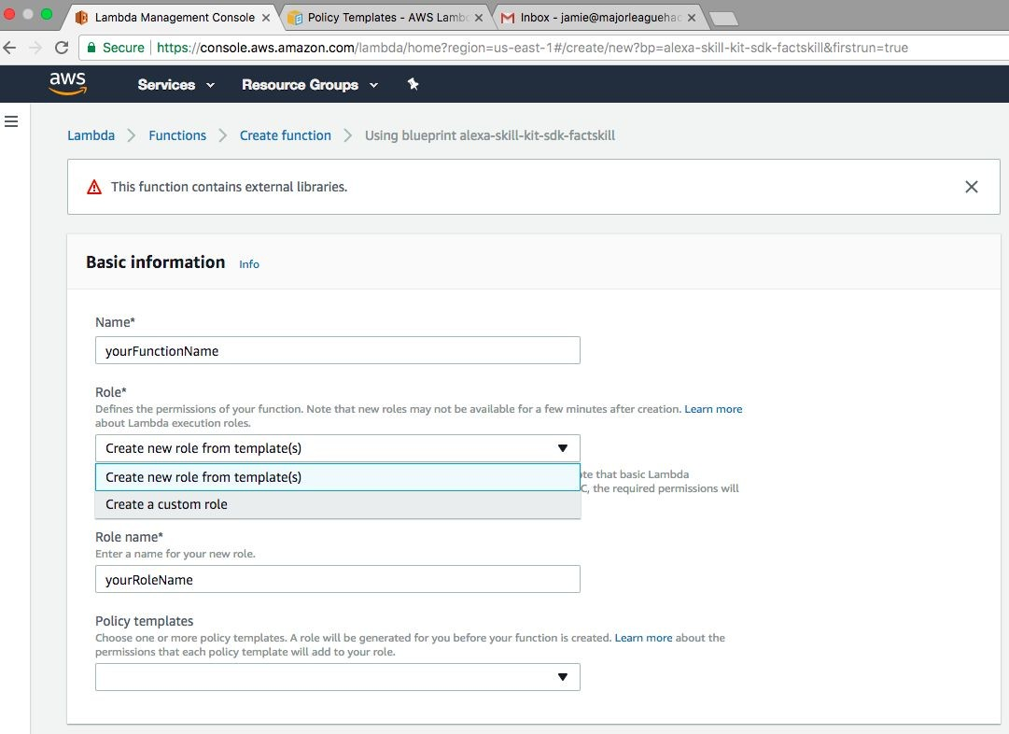
Set Basic Information.
Instructions
Enter a name, select “Create a custom role,” and name your role.

Slide 34
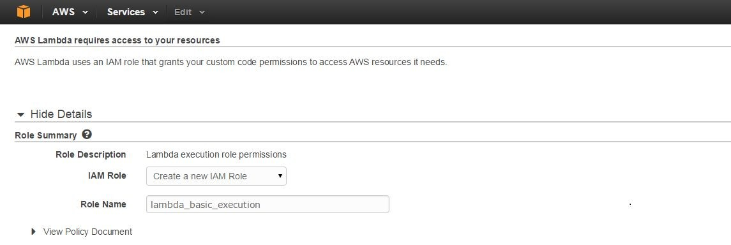
Create your IAM Role.
Instructions
Select "Create a new IAM Role" from dropdown menu.
Role Name & policy will automatically populate.
Select “Allow” in the lower right corner and you will be returned to your Lambda function.

Slide 35
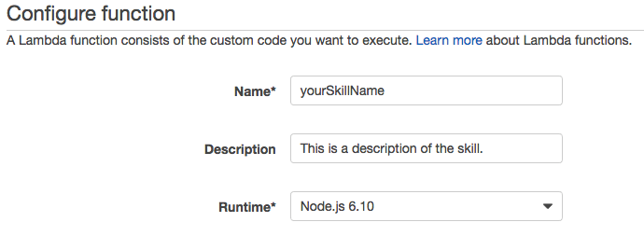
Configure your Lambda Function
Enter a Name, Description, and select "Node 6.1" as the Runtime for your skill as in the example.
Notes:
What to Say:
AWS Lambda Functions have some basic configuration options
Name is what your function is called
Description is a short sentence to help describe what the function does to you
Runtime is the programming environment the function uses. Leave this as the default (Node.js 6.10)
What to Do:
Ask participants to fill out the form and leave the default runtime (Node.js 6.10).
Walk around and make sure they are finding everything OK

Slide 36
Step 1: Download the Sample Code
To get the sample code, head to this URL:
https://app.box.com/s/qyhzcmt0d4z3fts3lxxrdfl44n77yil4
Step 2: Open Index.js
Unzip the directory and open src/index.js in your favorite code editor.

Slide 37
Customize your Facts
Find the FACTS array inside index.js. Replace the facts about Capgemini with some facts about yourself!
12 // TODO: replace with facts about yourself
13 const FACTS = [
14 "Capgemini has locations in 40 countries around the world.",
15 "Capgemini's mission is that people matter and results count.",
16 “Capgemini had over 12.8 Billion EUR in global revenue in 2017",
17 "Capgemini was founded by Serge Kampf.",
18 "Capgemini celebrated its 50th birthday in October 2017.",
19 "Capgemini’s Logo came from a card game called Bridge. The spade is the highest value card in the game.",
20 "Capgemini is headquartered in Paris France."
21 ];
Notes:
What to Say:
The first section of this file contains a list of facts about Capgemini.
We store this in a variable called “FACTS”
We’re going to replace these with some facts about you!
What to Do:
Ask participants to replace the list of facts with facts about themselves. This should take about 5-10 minutes.
Remind them to wrap their facts in quotation marks (“EXAMPLE TEXT”)
Each line needs to end with a comma (“,”) except the last one
Walk around and make sure everyone is able to open the file.

Slide 38
Code Review: The Handlers Object
The handlers object tells Alexa how to handle various actions. GetFact is the main logic of our application.
23 var handlers = {
24 'LaunchRequest': function() { this.emit('GetFact'); },
25 'GetNewFactIntent': function() { this.emit('GetFact'); },
26 'GetFact': function() {
27 // Randomly select a fact from the array
28 const factIndex = Math.floor(Math.random() * FACTS.length);
29 const randomFact = FACTS[factIndex];
30
31 // Create speech output
32 const speechOutput = "Here's your fact: " + randomFact;
33 this.emit(':tellWithCard', speechOutput, "Capgemini Facts", randomFact);
34 }
35 };
Notes:
What to Say:
The next section maps intents (Launch and Get New Fact) to actual code.
Both “LaunchIntent” and “GetNewFactIntent” trigger the “GetFact” function.
The GetFact function does the following:
Select a random element from the FACTS list
Prepend “Here’s your fact” to the fact
Tell Alexa to respond with the fact by emitting a “:tellWithCard” event.
What to Do:
Walk participants through the code and make sure everyone understands.

Slide 39
Code Review: The Handler Function
The handler function tells Alexa how to route voice commands by passing a copy of the handlers object.
37 // AWS Lambda calls this function every time Alexa uses our skill.
38 exports.handler = function(event, context, callback) {
39 // Include the AWS Alexa Library.
40 const Alexa = require("alexa-sdk");
41
42 // Create an instance of the Alexa library & pass it the requested command.
43 var alexa = Alexa.handler(event, context);
44
45 // Give our Alexa instance handling instructions & execute the request.
46 alexa.registerHandlers(handlers);
47 alexa.execute();
48 };
Notes:
What to Say:
The final section passes our configuration to Alexa using the Alexa SDK
We instantiate a new Alexa object and pass it the parsed speech the user gave us
Register the list of handlers we created in the last section so Alexa knows how to respond.
Execute the request.
What to Do:
Walk participants through the code and make sure everyone understands.

Slide 40
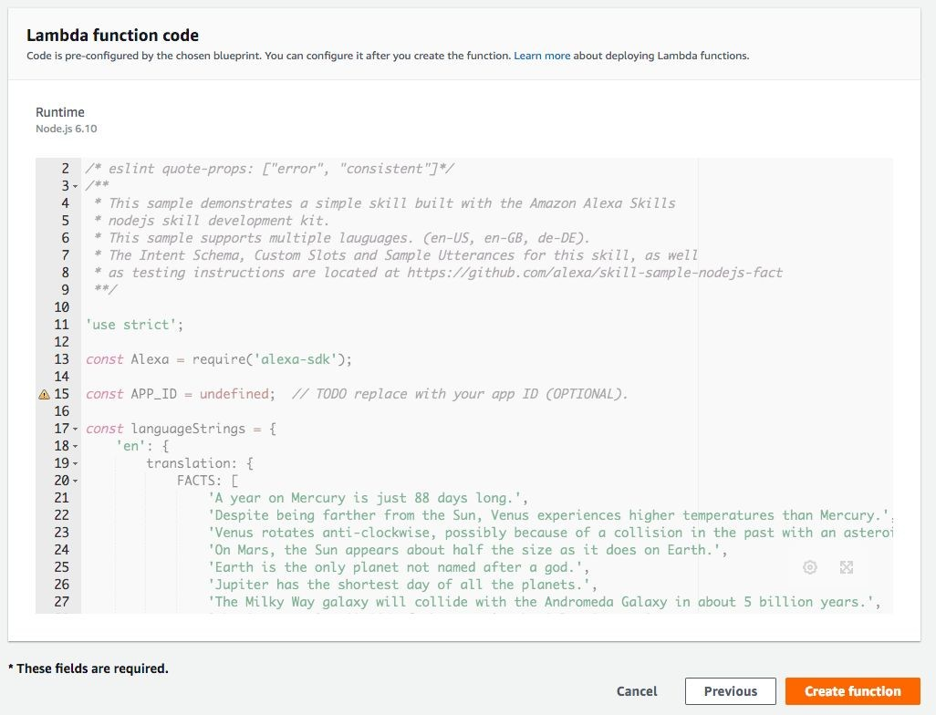
Create your Function.
Instructions
Click “Create Function” at the bottom of the page

Slide 41
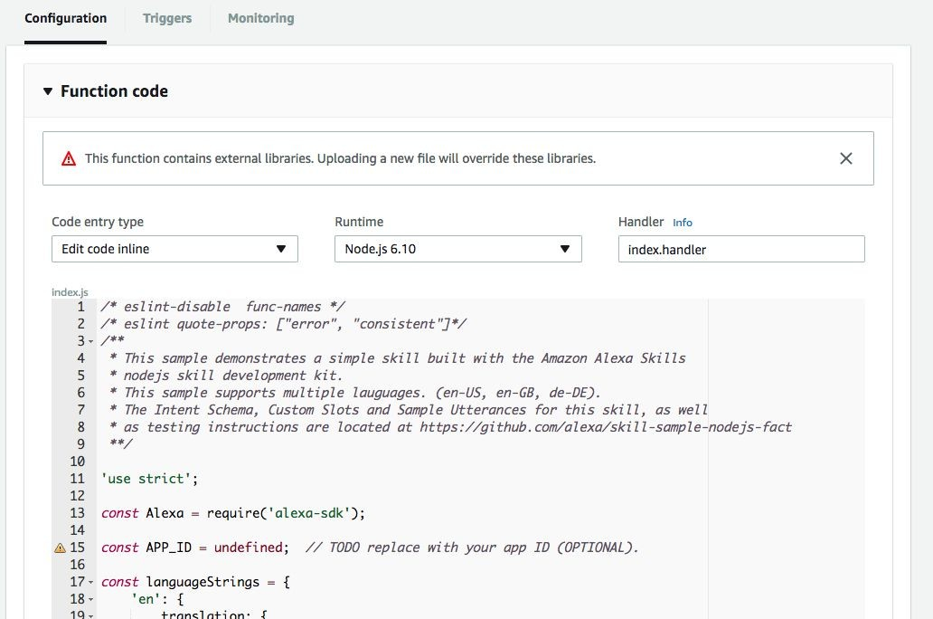
Copy & Paste your Code into the Lambda Editor
Instructions
Copy the entire contents of index.js and paste it over the code in the inline editor on the AWS Console.

Slide 42
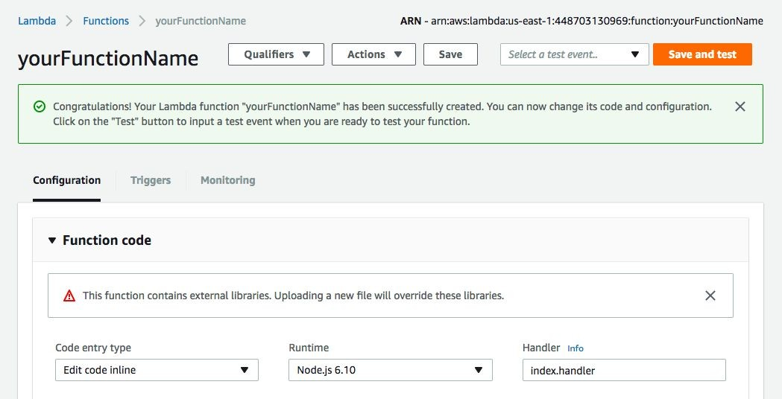
Save your Code.
Instructions
Click the white “Save” button (not the orange one).

Slide 43
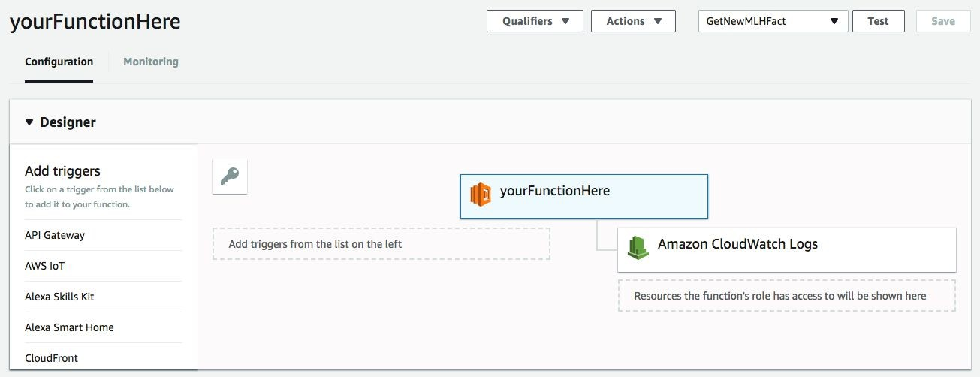
Configure your Trigger.
We need to setup a trigger to call our new Lambda Function (in our case Alexa Skills Kit).
Instructions
Click “Alexa Skills Kit"

Slide 44
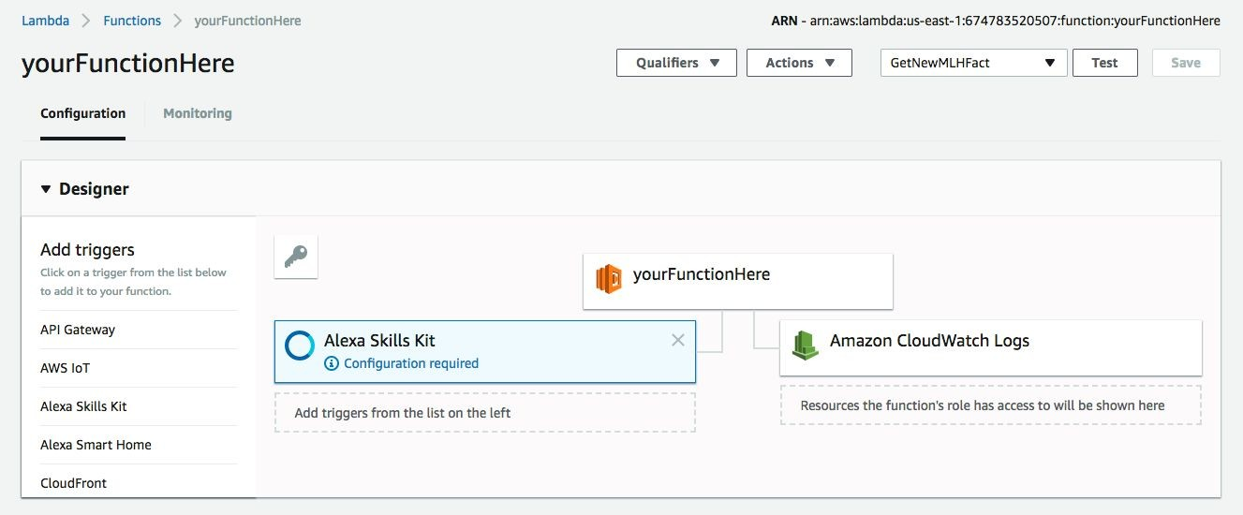
Test your Trigger.
Instructions
Click “Configure Test Events.”

Slide 45
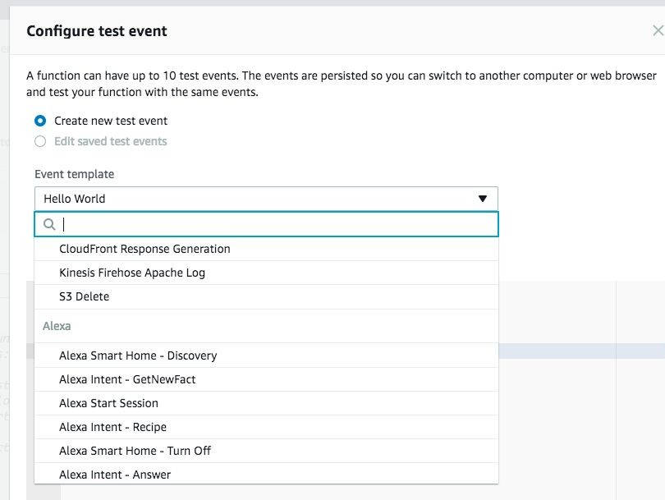
Test your Trigger.
Instructions
Click “Hello World.
Scroll down and select “Alexa Intent - GetNewFact.”

Slide 46
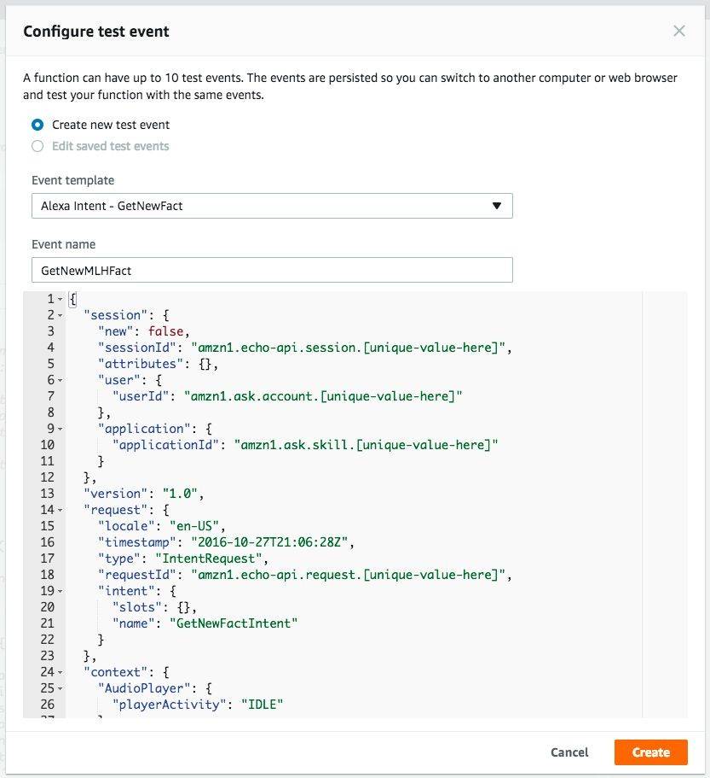
Test your Trigger.
Hacking with Amazon Alexa
Instructions
Name your test event. Click “Create.”
GetNewCapgeminiFact

Slide 47
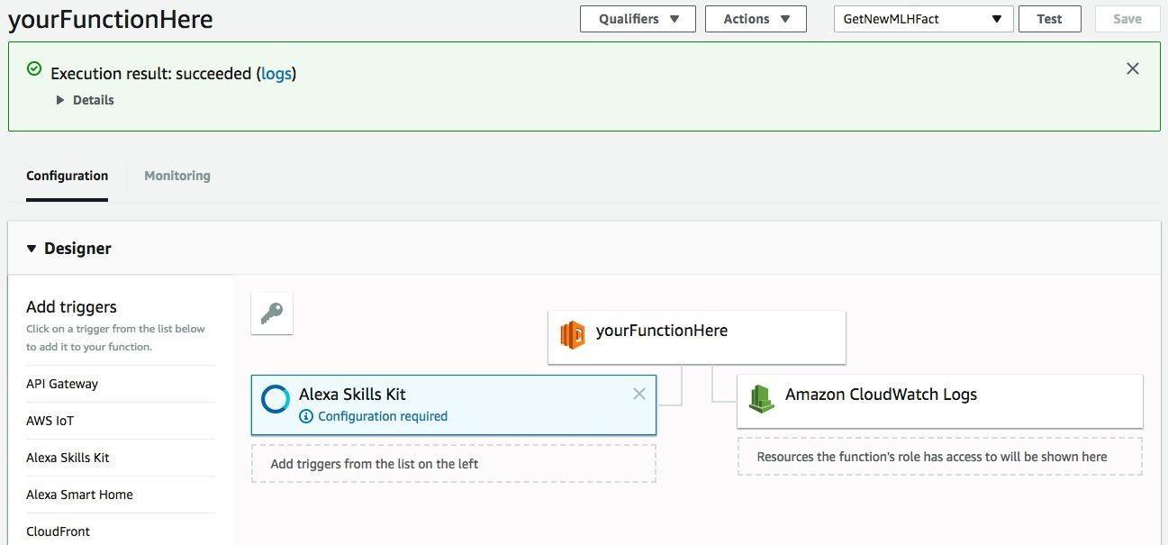
Test your Trigger.
Instructions
Click “Test.”

Slide 48
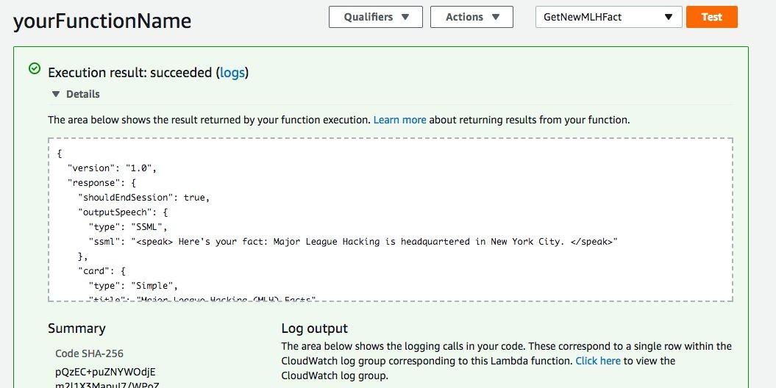
Test your AWS Lambda Function
If it’s working, you can click “Details” to see output similar to the following:
Capgemini is headquartered in Paris, France. </speak>”

Slide 49
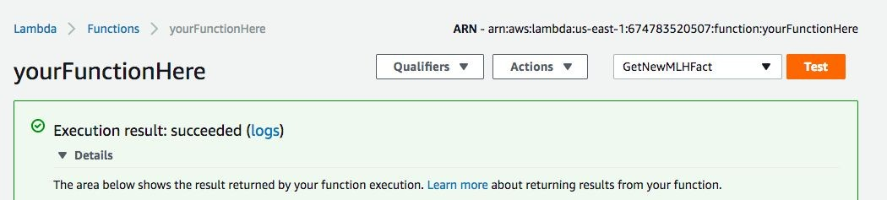
Note your Function’s ARN.
You’ll need it in a few steps, so either keep this tab open or save it in a file somewhere now.

Slide 50
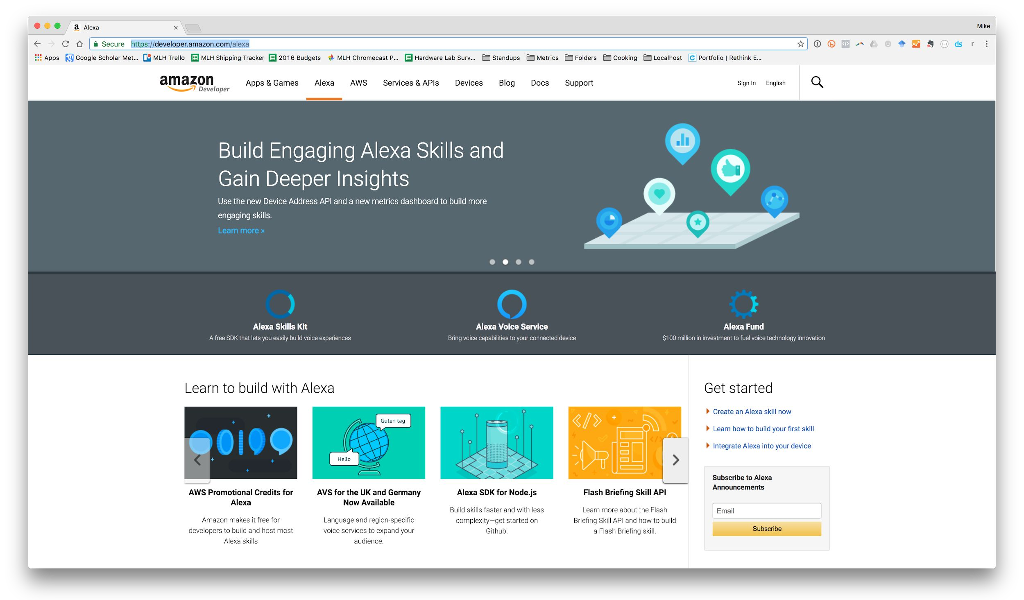
Sign into the Amazon Developer Portal.
Head over to:
developer.amazon.com

Slide 51
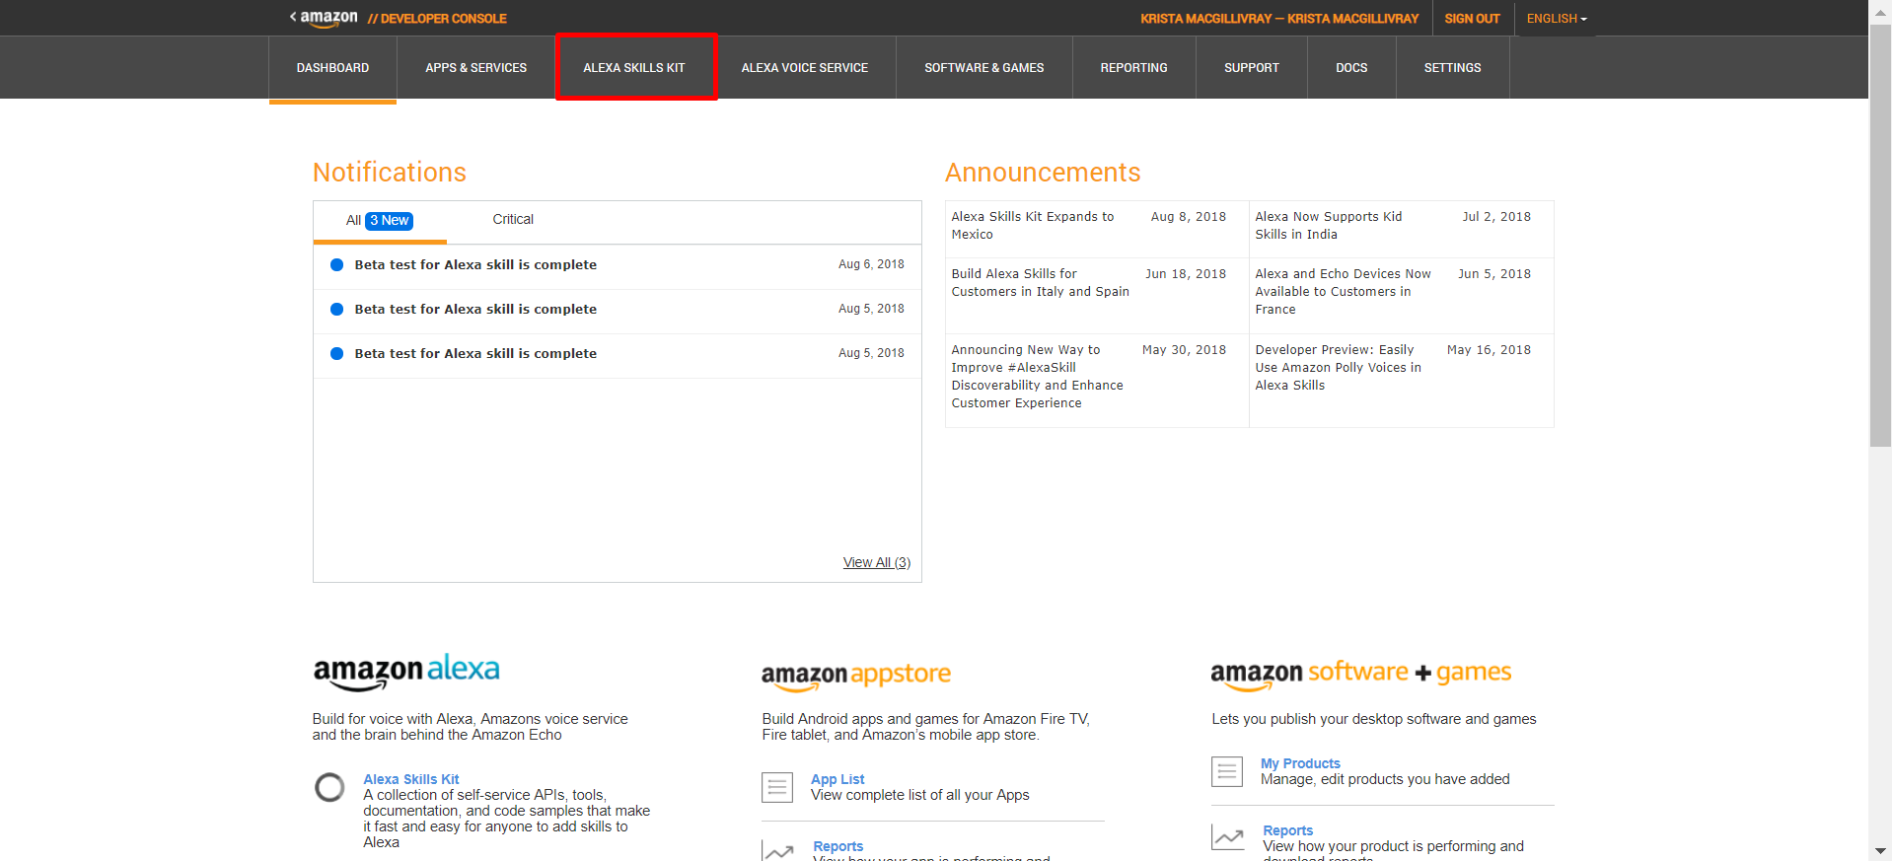
Create a New Alexa Skill.
Instructions
Navigate to the Alexa tab.

Slide 52
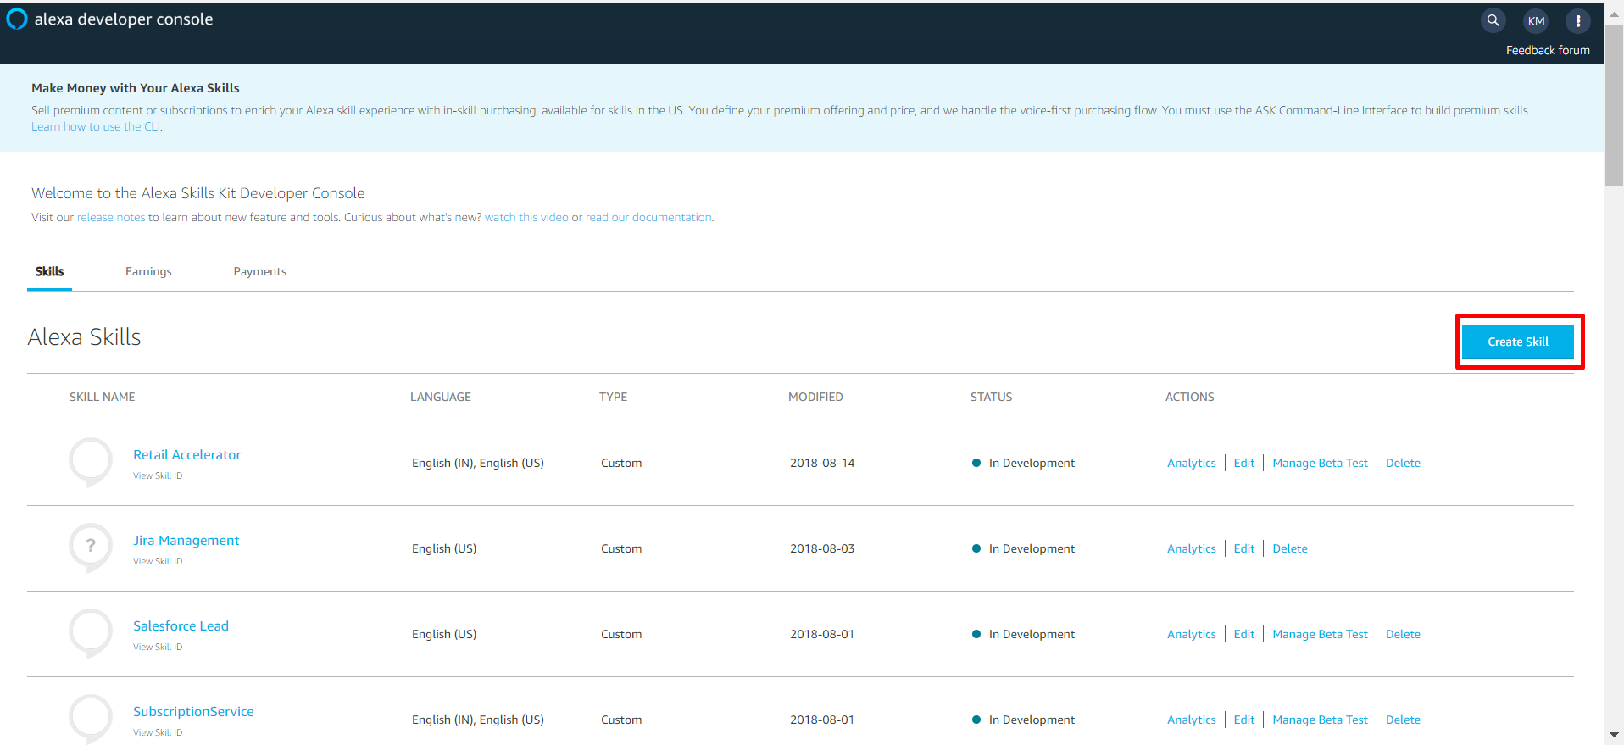
Create a New Alexa Skill
Instructions
Click on "Getting Started" under “Alexa Skills Kit.” Click “Add a New Skill” in the top right.

Slide 53
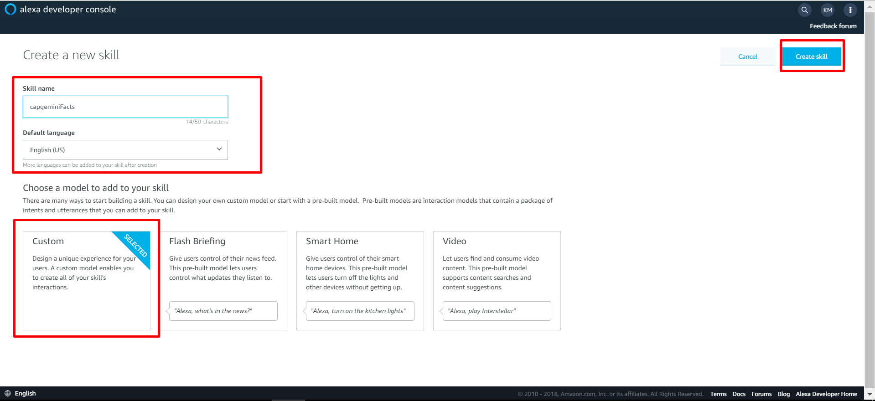
Name your Skill
Instructions
Select “Custom Interaction Model” for Skill Type.
Enter a Name for your Skill.
Enter an Invocation Name for your Skill.
Select the "No" option under Audio Player and click “Next”.

Slide 54
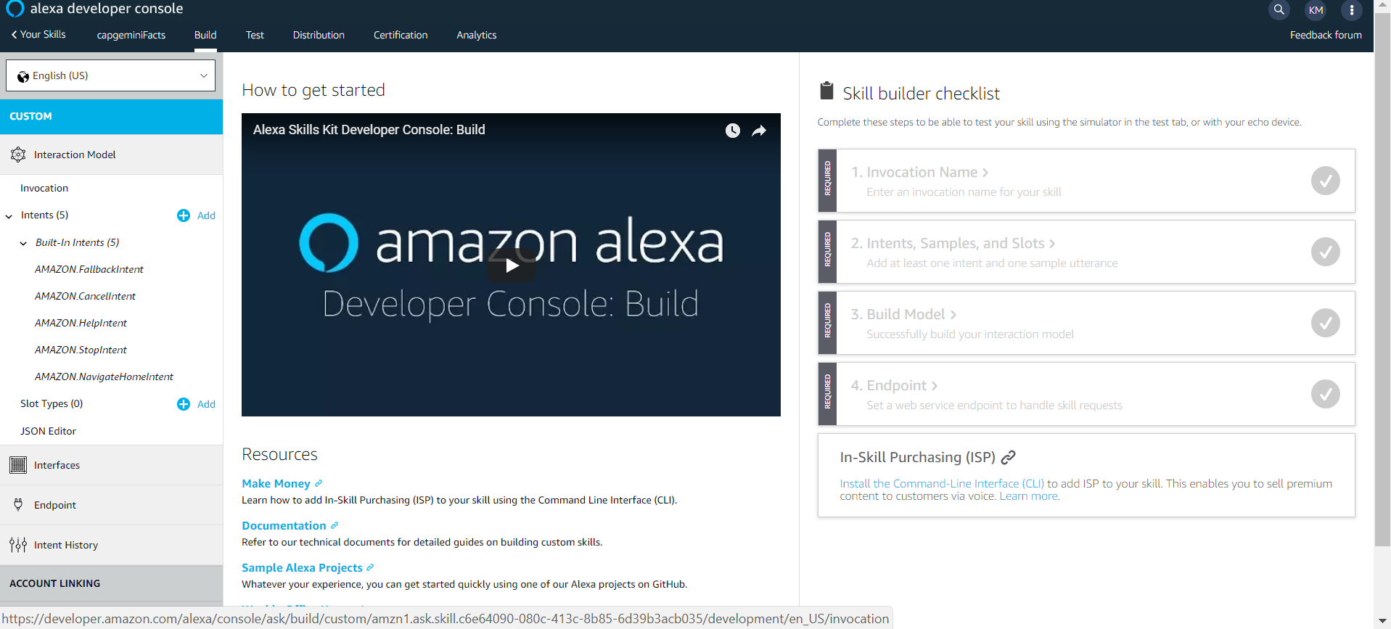
Give an Invocation Name

Slide 55
What is the Invocation Name?
This is a 1-3 word phrase that users will say out loud to launch your skill.
Alexa, open Capgemini facts.
Wake Word
Launch
Skill Invocation Name

Slide 56
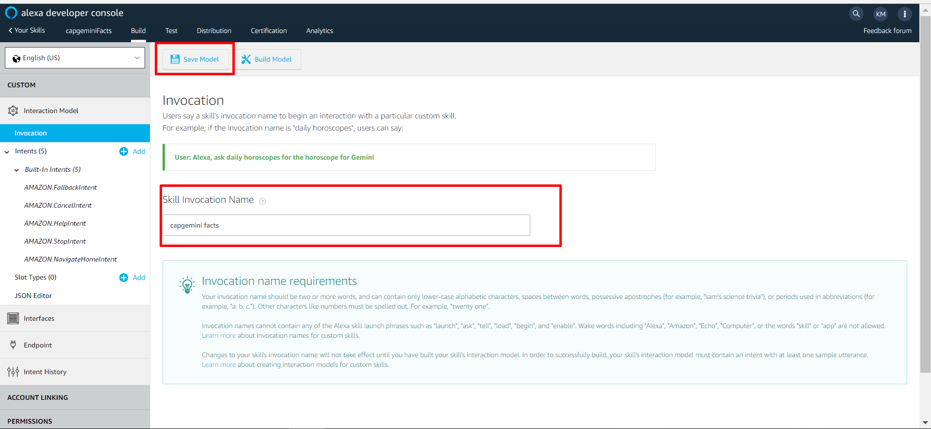
Save Model

Slide 57
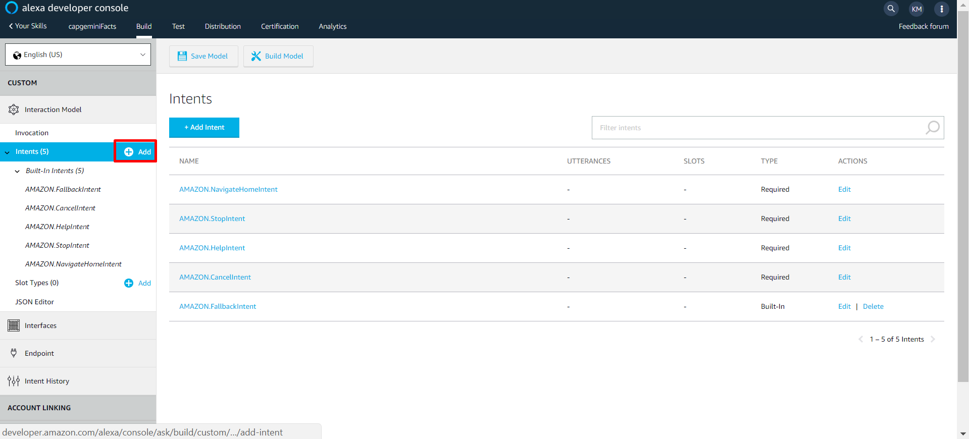
Add a New Intent
On the left side pane, select the +Add button to add a new intent. Notice the out of box intents which are already available.
This code tells Alexa which code to trigger in our Lambda Function and some basic defaults like “STOP” and “HELP”.

Slide 58
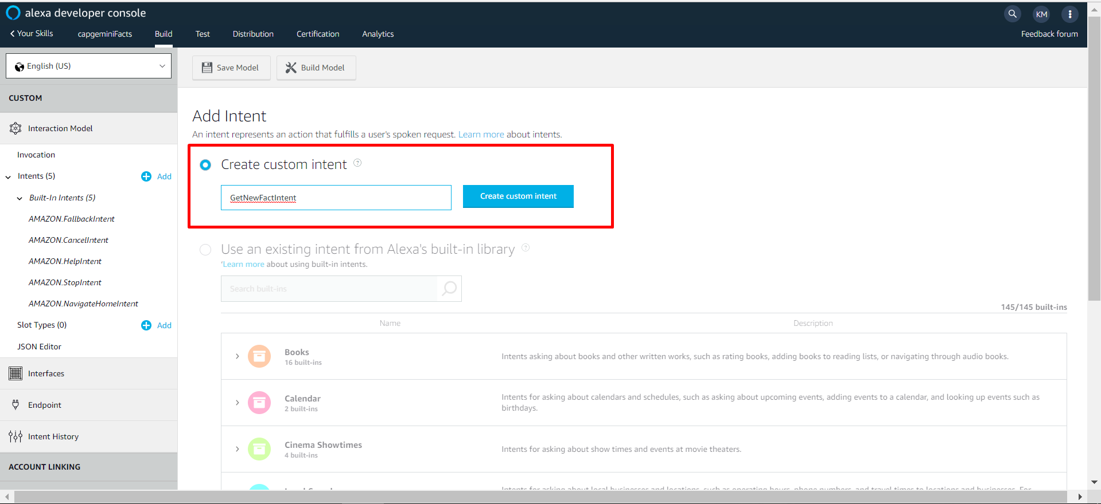
Paste the JSON into the Intent Schema Box
Instructions
Add a new intent called ‘GetNewFactIntent’ and then select Create Custom Intent

Slide 59
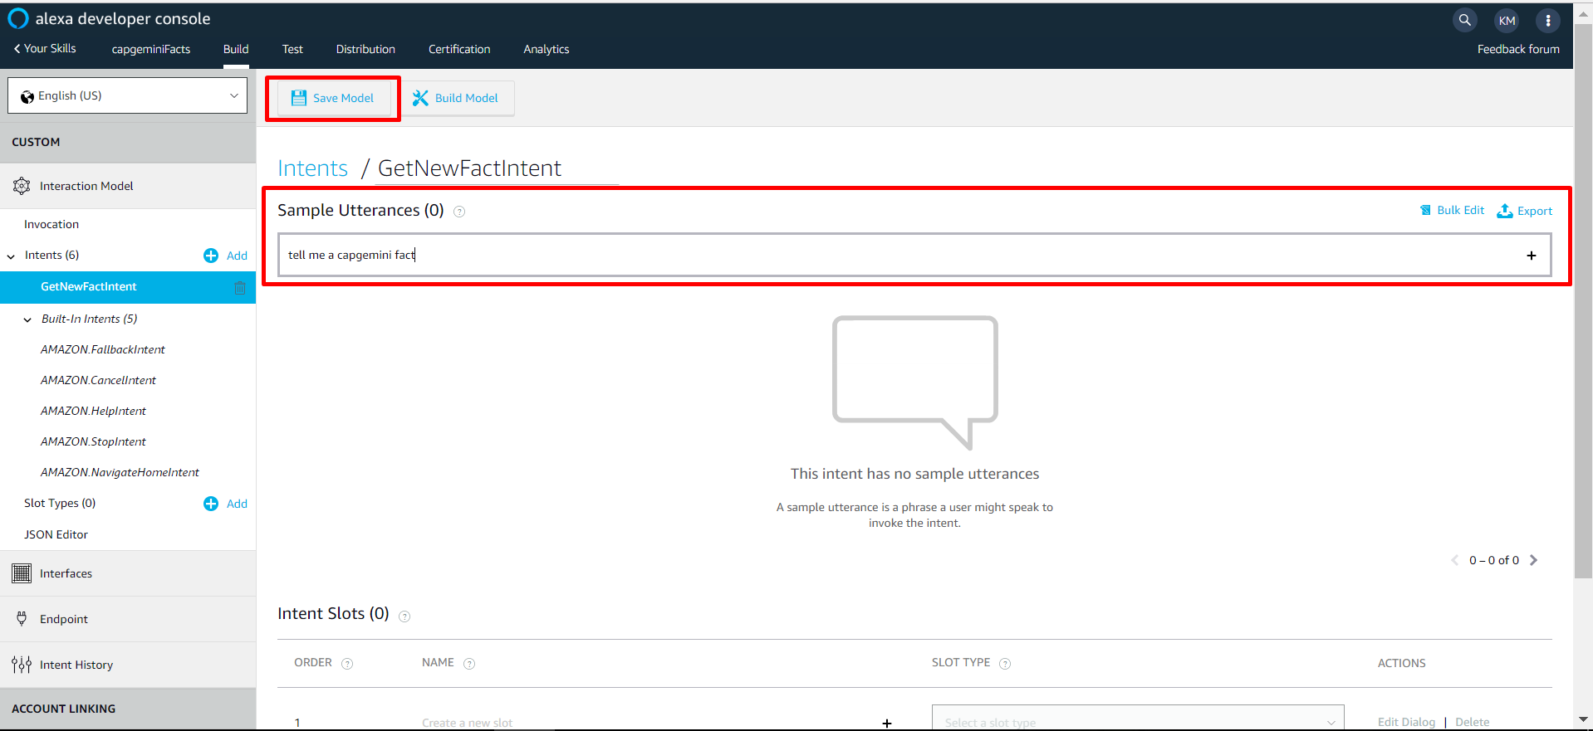
Customize Your Utterances
Instructions
Open up SampleUtterances.txt and add the sample utterances to the new intent

Slide 60
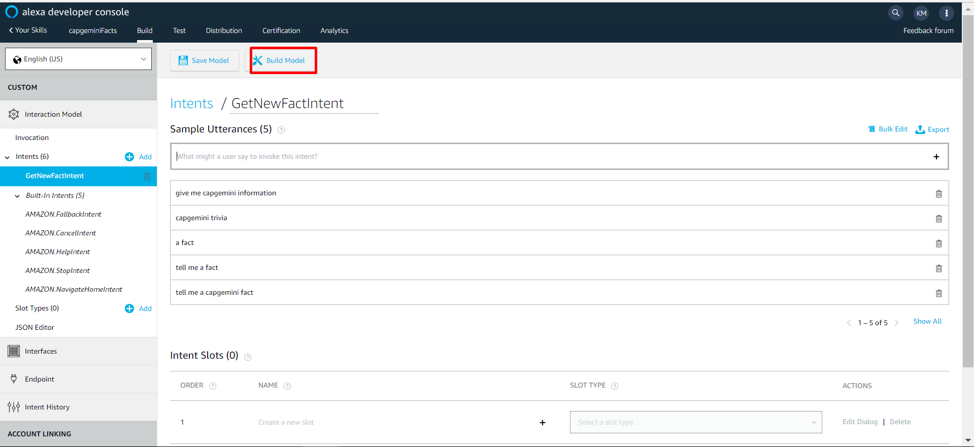
Save & Build Your Interaction Model and Continue.
Instructions
Once you’ve defined your intent schema & sample utterances, save and then build your model.

Slide 61
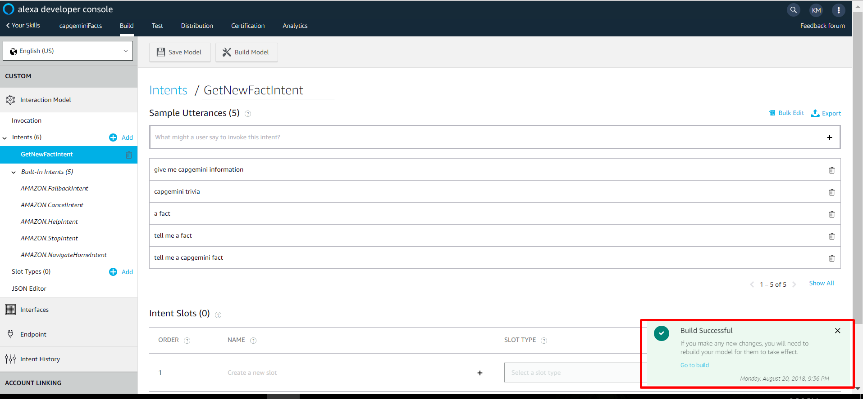
Ensure Build is Successful
Instructions
.
You will be notified once the build is successful. Select ‘go to build’ once finished
Notes:
You will be notified once the build is successful. Select ‘go to build’ once finished

Slide 62
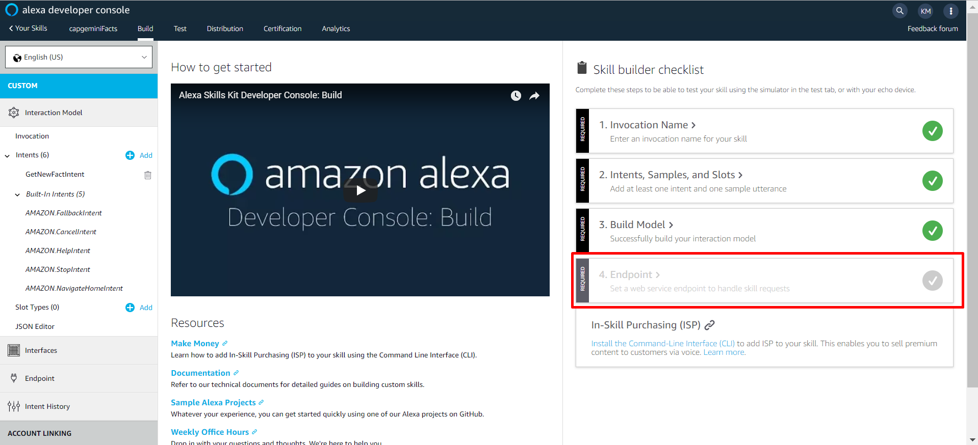
Setup Endpoint
You should see three green check marks now. All that is left is to add your endpoint.
Instructions
.

Slide 63
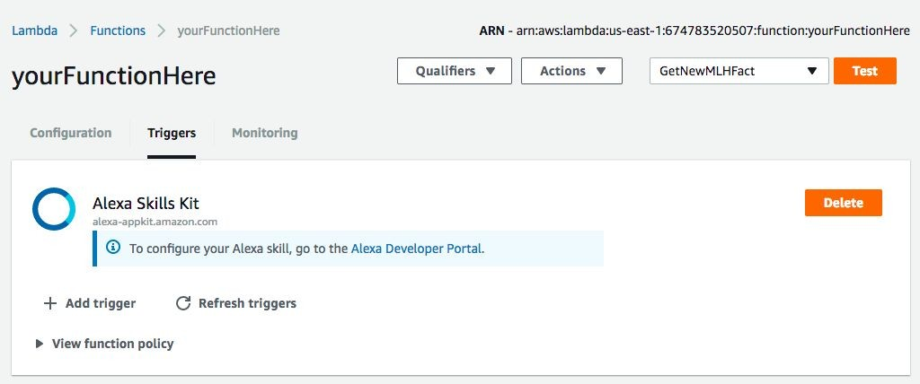
Go get your Lambda Function’s ARN
Instructions
.
Remember the ARN we noted down earlier?
Retrieve it now!

Slide 64
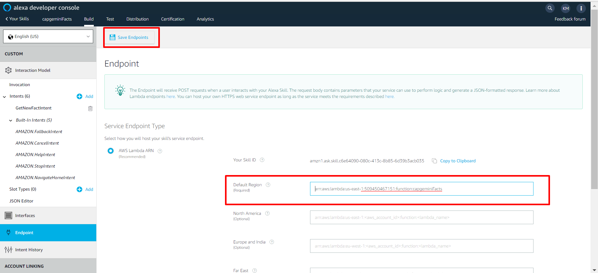
Connect Your Lambda Function to Your Skill.
Instructions
Add the ARN into the Default Region option and select ‘Save Endpoints’

Slide 65
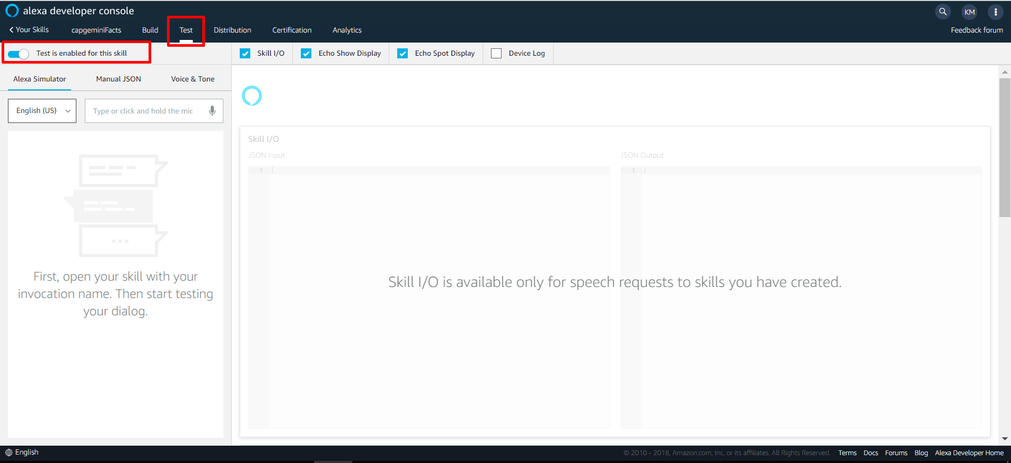
Enable Testing
Instructions
Click on the ‘Test’ tab and make sure that testing is enabled.

Slide 66
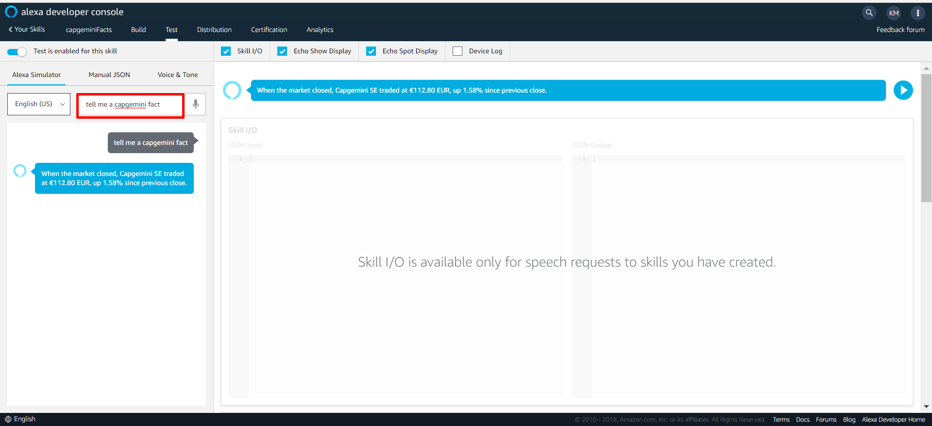
Test your Skill
Instructions
Type one of your sample utterances into the Alexa simulator to see how Alexa would respond.

Slide 67
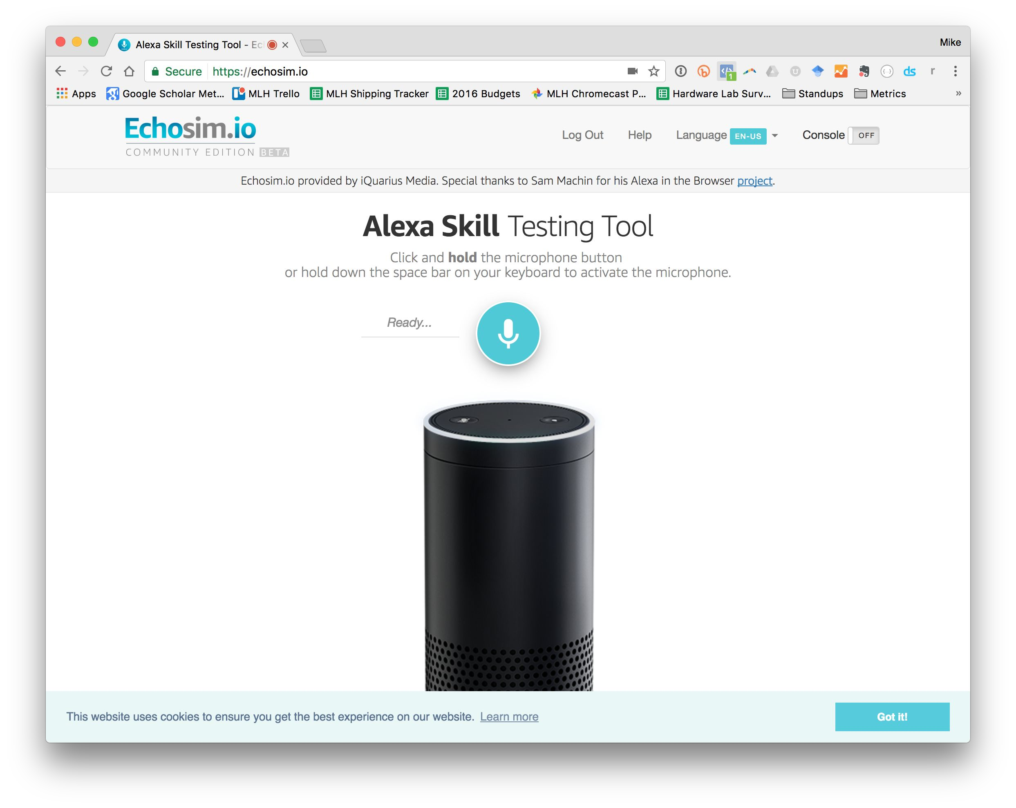


Try out Your Skill!
Hacking with Amazon Alexa
Head to EchoSim.io to try out your fact.
“Alexa, open [Your Invocation Name].”
If you want to try your skill on an Alexa Device, pair it with your account first!

Slide 68
Troubleshooting Your Skill
If you aren't getting a valid response, check the following:
Do you have the right ARN copied from your Developer Portal/Skill into your your Lambda function?
Are you calling the right invocation name?
Are you saying launch, start or open?
Are you sure you have no other skills in your accounts with the same invocation name?

Slide 69
Chapter 5: Review

Slide 70

Let’s recap quickly...
1
Voice User Interfaces allow us to physically separate ourselves from devices.
2
Amazon Alexa makes it easy for you to create apps (skills) that utilize Voice User Interfaces.
3
Alexa takes care of speech recognition and context so you can focus on making a great app.
Notes:
What to Say:
Here’s a quick summary of the main points we covered
Voice User Interfaces are a new type of interface that allow us to physically separate ourselves from devices.
Amazon Alexa makes it easy for you to create apps (called skills) that utilize Voice User Interfaces to do things.
Amazon Alexa takes care of hard stuff like speech recognition and context so you can focus on making a great app.
What to Do:
Summarize the workshop learnings and recap what participants accomplished over the last hour or so.

Slide 71
Chapter 6: Next Steps

Slide 72
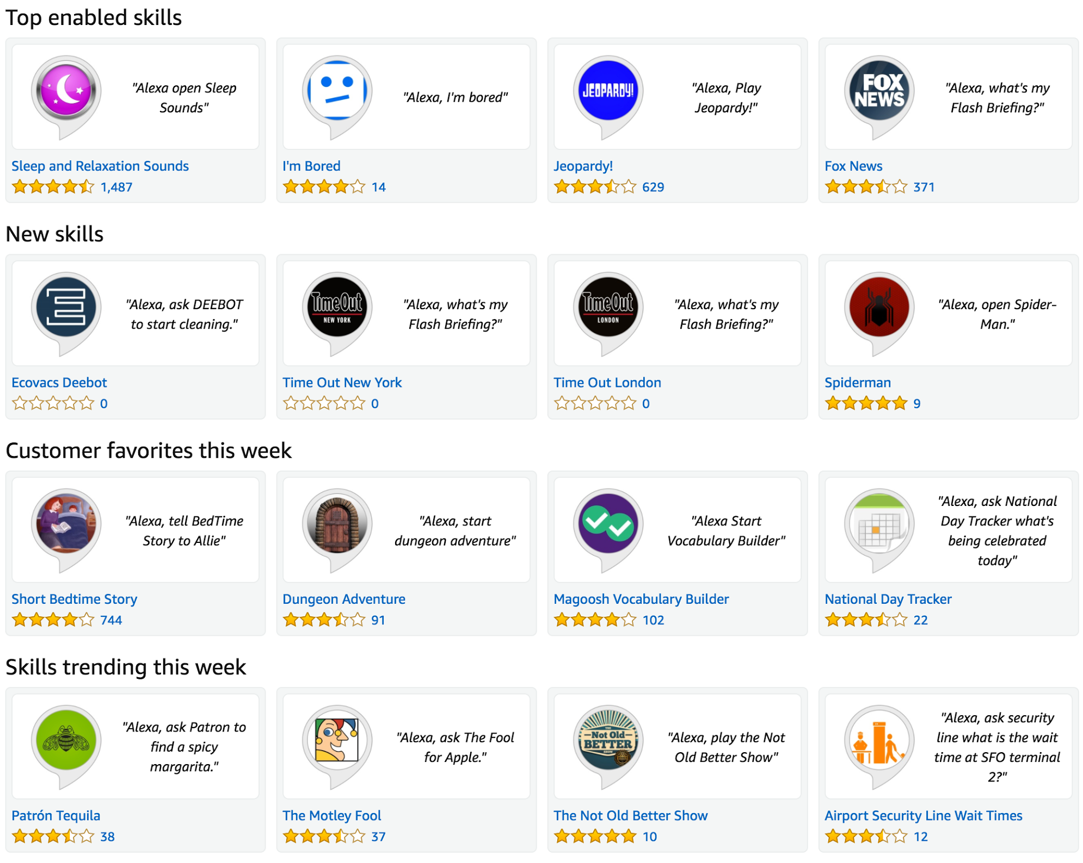
Next Steps: Publish your Skill!
You have a working skill, the next step is to publish it on the Alexa Skill Marketplace.
Instructions
Complete the “Publishing Information” and “Privacy and Compliance” sections on the developer portal.
Ensure that your skill meets the basic requirements.
Notes:
What to Say:
The most obvious next step is to actually publish your skill
You have a fully working skill that you could make available to Amazon Alexa devices everywhere
How cool will it be to show your friends your working skill?
This is also a great thing to add to your resumes.
What to Do:
Encourage participants to submit their skill before they head home for the day.
Give the overview of this challenge and move on to the next slide. The full details will be in participants emails.

Slide 73

Next Steps: Use Slots to Customize Further
Slots enable you to pass additional data to your Lambda function. Use slots to return a fact in a specific category (Ex. “facts about my education”).
Instructions
Read up about Slots and how to use them to pass data to your function.
Categorize your facts into a handful of groups.
Customize your function to return a fact based on the user specified category

Slide 74
Questions?

Slide 75



- End of Presentation -
Thank you

